Slide 1
Mailbox Nofitier
By David Sørensen

Slide 2

Mail or not?
The struggle not knowing when we got mail

Slide 3

Mailbox Notifier
Detect when the mailslot has been open
Notify you by visial and online
Flag
SMS

Slide 4
Requirements
When slot is opened
Flag is set
Sms is to be sent
When mail is retreived, the system can be reset with a system reboot

Slide 5

Technical challenges
Send sms with photon
Get phone-number with Twilio
Create integration in console.particle

Slide 6
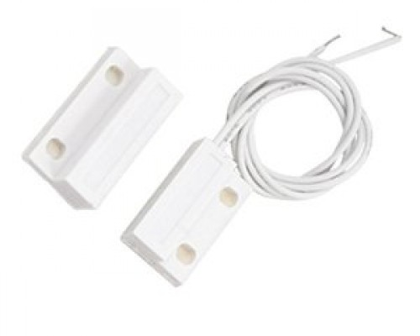
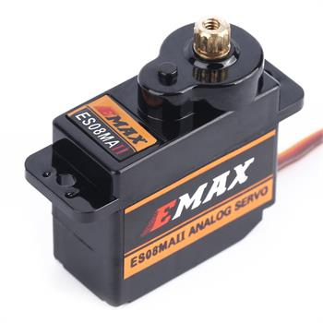
Hardware
Sensor to register an open mailslot
Analog reading
0 when connected
Servomotor to set flag
Notes:
Magnetic contact
Servomotor

Slide 7
Testing
Servo motor
Power with battery
Controle with particle app
Set servo-angel
Sensor (done)
Connected it to an analog pin
Read from it with particle app
Both when connected and disconnected
SMS (done)
Setup twilio account
With phone-number
Create an integration feature on console.particle
Test with test-script

Slide 8
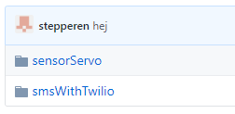
Github
https://github.com/stepperen/IOT

